Slide 1
Creating Callback Functions

Slide 2

What you will learn

Slide 3
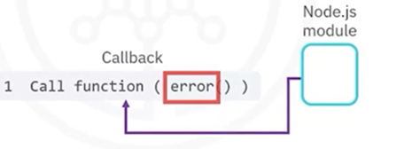
Propagating errors
• Node.js makes extensive use of callback functions to return the
result to the calling function
• Node.js modules pass an error object as the first parameter in a
callback function

Slide 4
Propagating errors
• With this convention, the callback function checks if the first
parameter holds an error object
• If error is defined, the callback function handles the error and
cleans up any open network or database connections
• If error is not defined, then the callback function examines the
result from the call

Slide 5
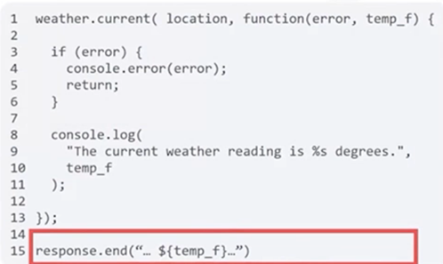
Callback with error handling
• If the error parameter is defined, print the error
• Otherwise, the weather.current function
call completed successfully
• Print the result from the
function call

Slide 6
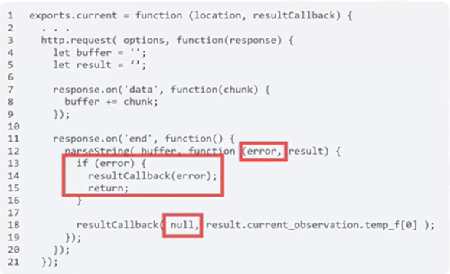
Passing an error object
• If parseString passes an error object, pass the error back to the resultcallback callback function of the original caller
(main app)
• Set the first parameter as null if there is no error

Slide 7

Passing the HTTP response message
• The callback handler can print the contents of the HTTP
response message body to the console or log the contents into
a database

Slide 8
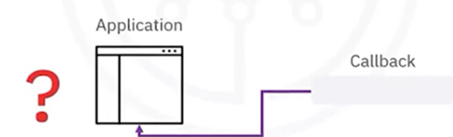
Passing the HTTP response message
• The callback handler can print the contents of the HTTP
response message body to the console or log the contents into
a database
• What if you wanted your callback handler to return the
response message to the original calling application?

Slide 9

Passing the HTTP response message
• You cannot use a return function because Node.js might call
the callback function after the http.request() call completes

Slide 10
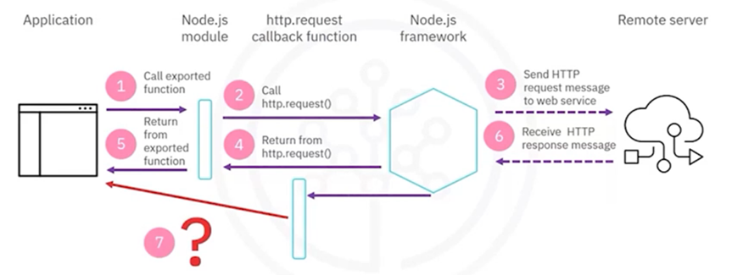
No link between callback and main

Slide 11
One callback at each level
• When one Node.js application calls a module in a non-blocking
manner, the application must provide a callback function to
process the result
• If the main application calls http.request(), it must provide a
callback handler to process the HTTP response message

Slide 12
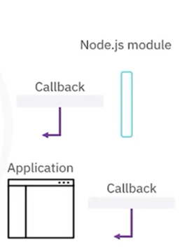
One callback at each level
• If the main application calls a function that calls http.request(), two callback functions are involved:
• The custom module has a callback function to handle the HTTP response message from http.request()
• The main application has a callback function that processes the result that is captured in the first callback function

Slide 13
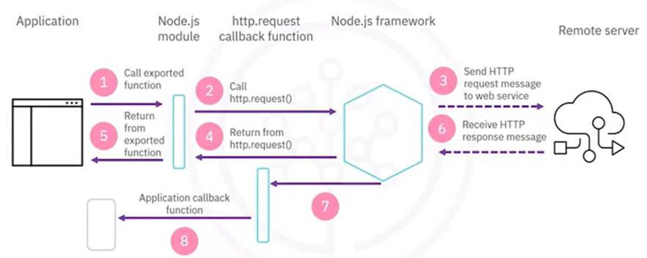
Solution: Capture the result

Slide 14
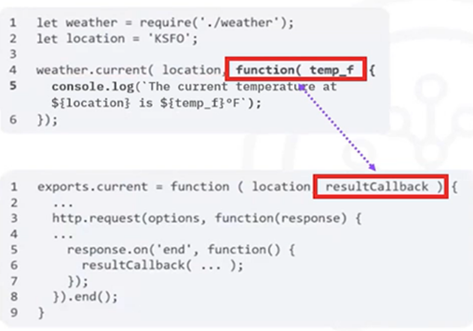
Main application with callback
• The resultCallback callback function in the
function of the custom Node.js module links to
the anonymous callback function function
(temp_f) of the weather.current function
in the main application

Slide 15
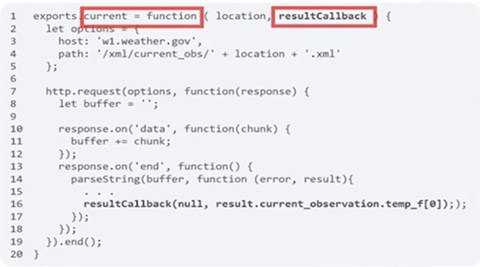
Return a result with callback
• The resultCallback parameter stores
the anonymous callback function
from the main application

Slide 16
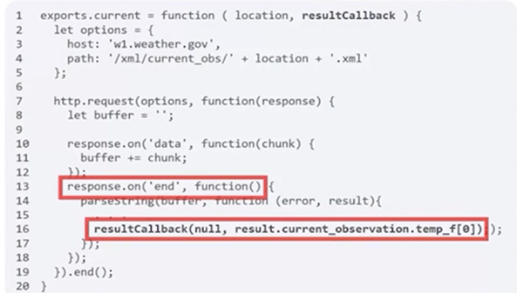
Return a result with callback
• The http.request() callback function calls
resultCallback to return the result
to the main application

Slide 17
Recap
In this video, you learned that:
• Node.js makes extensive use of callback functions to return the
result to the calling function
• Node.js modules in the SDK pass an error object as the first
parameter in a callback function
• There is one callback function at each level

